Slide 1
Unit VI
COMPUTATIONAL COMPLEXITY

Slide 2
Outline
Decidability
Reducibility
Time Complexity

Slide 3



Undecidability and Complexity
Undecidability
Recursive and recursively enumerable languages.
Universal Turing Machines.
Limitations on our ability to compute; undecidable problems.
Computational Complexity
Decidable problems for which no sufficient algorithms are known.
Polynomial time computability.
The notion of NP-completeness and problem reductions.
Examples of hard problems.
Let’s start with a big-picture overview of these topics

Slide 4
Recall that:
A language L is Turing-Acceptable if there is a Turing machine M that accepts L
Also known as: Turing-Recognizable
or
Recursively-enumerable
languages

Slide 5
w∈ L M halts in an accept state
For any string w :
M halts in a non-accept state
or loops forever
w ∉ L

Slide 6
Definition:
A language L is decidable
if there is a Turing machine (decider) M
which accepts L
and halts on every input string
Also known as recursive languages

Slide 7
w∈ L M halts in an accept state
For any string w :
w ∉ L
M halts in a non-accept state
Every decidable language is Turing-Acceptable

Slide 8
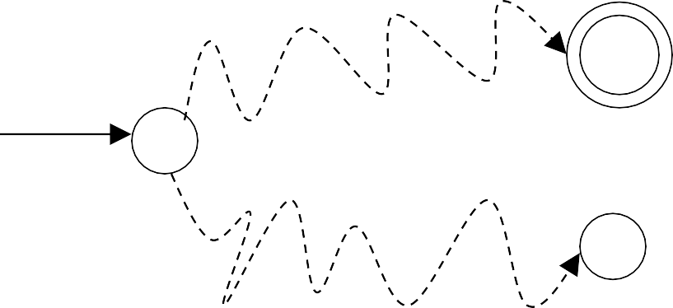
For a decidable language L :
Decision On Halt:
Accept
Decider for L
^{q}accept
Input string
Reject
^{q}reject
For each input string, the computation halts in the accept or reject state

Slide 9
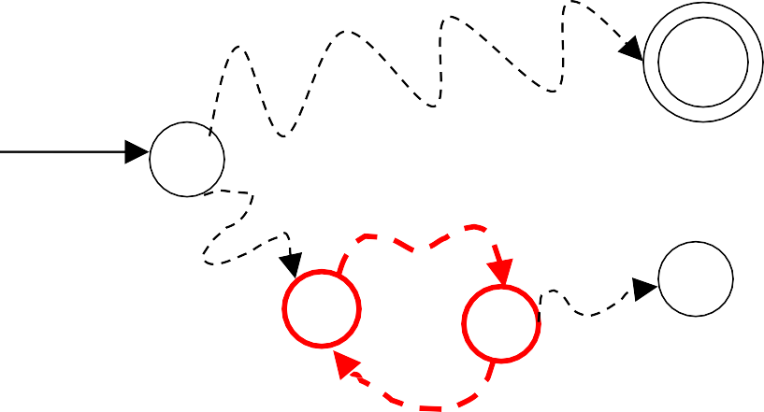
For a Turing-Acceptable language L :
Turing Machine for L
^{q}accept
Input string
^{q}reject
It is possible that for some input string the machine enters an infinite loop

Slide 10
Problem: Is number x prime?
Corresponding language:
PRIMES = {1, 2, 3, 5, 7, …}
We will show it is decidable

Slide 11
Divide x
Decider for PRIMES : On input number x :
with all possible numbers
between 2 and
x
If any of them divides x
Then reject Else accept

Slide 12
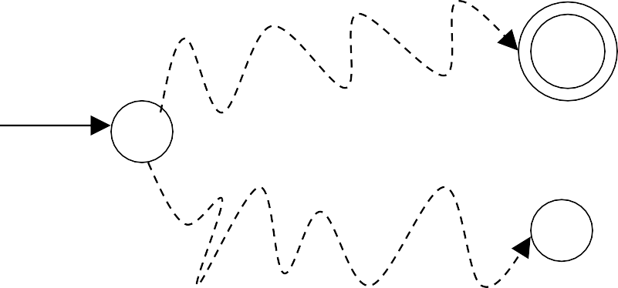
the decider for the language solves the corresponding problem
Decider for PRIMES
^{q}accept
YES
(Accept)
NO
(Reject)
Input number x
(Input string)
is x prime?
^{q}reject

Slide 13
Theorem:
If a language L is decidable,
then its complement L is decidable too
Proof:
Build a Turing machine M ′ that
accepts L and halts on every input string
( M ′ is decider for L )

Slide 14
M M ′
Transform accept state to reject and vice-versa
^{q}accept
q_{a}
^{q}reject
q_{r}
^{q}r′eject
q_{a}
^{q}a′ccept
q_{r}

Slide 15
Turing Machine M ′
On each input string w do:
1. Let M be the decider for L
2. Run M with input string
w
If M accepts then reject If M rejects then accept
Accepts L and halts on every input string
END OF PROOF

Slide 16
Decidability vs. Undecidability
There are two types of TMs (based on halting):
(Recursive)
TMs that always halt, no matter accepting or non-
accepting ≡ DECIDABLE PROBLEMS
(Recursively enumerable)
TMs that are guaranteed to halt only on acceptance. If non-accepting, it may or may not halt (i.e., could loop forever).
Undecidability:
Undecidable problems are those that are not
recursive
16

Slide 17
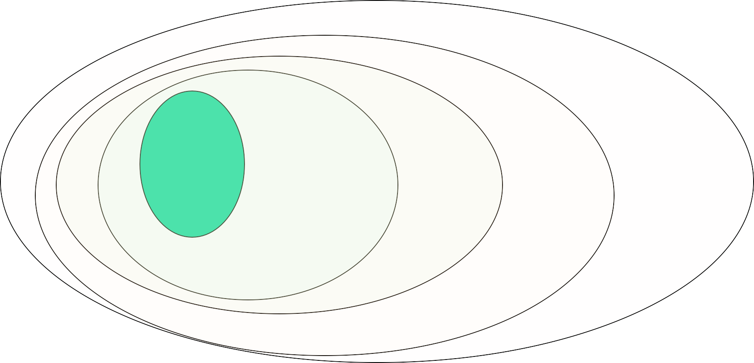
Recursive, RE, Undecidable languages
No TMs exist
TMs that always halt
LBA
Non-RE Languages
(all other languages for which no TMs can be built)
TMs that may or may not halt
Recursively Enumerable (RE)
Regular Context-
Context sensitive
(DFA)
free
(PDA)
Recursive
“Undecidable” problems
“Decidable” problems

Slide 18
Recursive Languages & Recursively Enumerable (RE) languages
Any TM for a Recursive language is going to look like this:
“accept”
w
M
“reject”
Any TM for a Recursively Enumerable (RE) language is going to look like this:
“accept”
w
M
“?”

Slide 19
Languages recognized by a TM are called recognizable/acceptable.
Languages decided by a TM are called decidable.

Slide 20



Closure Properties of:
the Recursive language class, and
the Recursively Enumerable
language class

Slide 21
Recursive Languages are closed under complementation
If L is Recursive, L is also Recursive
M
“accept”
“accept”
w
w
M
“reject”
“reject”

Slide 22
Are Recursively Enumerable Languages closed under complementation? (NO)
If L is RE, L need not be RE
M
“accept”
“accept” ?
w
w
M
?
“reject”

Slide 23
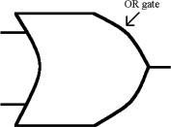
Recursive Langs are closed under Union
Let M_{u} = TM for L₁ U L₂ M_{u} construction:
Make 2-tapes and copy input w on both tapes
2. Simulate M₁ on tape 1
3. Simulate M₂ on tape 2
4. If either M₁ or M₂ accepts, then M_{u} accepts
5. Otherwise, M_{u} rejects.
M_{u}
■
accept reject
M₁
1.
OR
w
accept reject
M₂

Slide 24

Recursive Langs are closed under Intersection
Let M_{n} = TM for L₁ ∩ L₂ M_{n} construction:
Make 2-tapes and copy input w on both tapes
2. Simulate M₁ on tape 1
3. Simulate M₂ on tape 2
4. If M₁ AND M₂ accepts, then M_{n} accepts
5. Otherwise, M_{n} rejects.
M_{n}
■
accept reject
M₁
1.
AND
AND
w
accept reject
M₂

Slide 25
Other Closure Property Results
Recursive languages are also closed under:
Concatenation
Kleene closure (star operator)
Homomorphism, and inverse homomorphism
RE languages are closed under:
Union, intersection, concatenation, Kleene closure
RE languages are not closed under:
complementation

Slide 26
Decidable and Undecidable Problems
Problem
Solvable
Unsolvable
Decidable
(Algorithm)
Solution is definite
Undecidable
(Procedure)
Sometime yes or sometime no

Slide 27
Example of Decidable Problems
Does finite Automata Accept Regular Language?
L1 and L2 are two regular languages, are they closed under following property:
Union
Concatenation
Kleene Closure
If L1 and L2 is CFL then L1 U L2 is CFL?

Slide 28
Example of Undecidable Problems
For given context free Grammer G, is L(G) is ambiguous?
For two given CFL L1 and L2 whether L1 ∩ L2 is CFL or not?
A Computational problem is said to be unsolvable if no algorithm to solve it.
A problem is said to be undecidable if it is a decision problem and no algorithm can decide the solution.

Slide 29
For a decidable language L :
Decision On Halt:
Accept
Decider for L
^{q}accept
Input string
Reject
^{q}reject
For each input string, the computation halts in the accept or reject state

Slide 30
For a Turing-Acceptable language L :
Turing Machine for L
^{q}accept
Input string
^{q}reject
It is possible that for some input string the machine enters an infinite loop

Slide 31
Review
Decidability
Undecidability

Slide 32
Proofs of Decidability
How can you prove a language is decidable?

Slide 33
What Decidable Means
A language L is decidable if there exists a TM M such that for all strings w:
If w ∈ L, M enters q_{Accept}.
If w ∉ L, M enters q_{Reject}.
To prove a language is decidable, we can show how to construct a TM that decides it.
For a correct proof, need a convincing argument that the
TM always eventually accepts or rejects any input.

Slide 34
Proofs of Undecidability
How can you prove a language is undecidable?

Slide 35
Proofs of Undecidability
To prove a language is undecidable, need to show there is no Turing Machine that can decide the language.
This is hard: requires reasoning about all possible TMs.

Slide 36
Recall
Decidability
Undecidability
Recursive Enumerable and Recursive Language
Decidable Language

Slide 37
“Languages” vs. “Problems”
A “language” is a set of strings
Any “problem” can be expressed as a set of all strings that are of the form:
“<input, output>”
e.g., Problem (a+b) ≡ Language of strings of the form { “a#b, a+b” }
==> Every problem also corresponds to a language!!
Think of the language for a “problem” == a verifier for the problem

Slide 38
A Universal Turing Machine

Slide 39
A limitation of Turing Machines:
Turing Machines are “hardwired”
they execute only one program
Real Computers are re-programmable

Slide 40
Solution:
Universal Turing Machine
Attributes:
Reprogrammable machine
Simulates any other Turing Machine

Slide 41
Universal Turing Machine
simulates any Turing Machine M
Input of Universal Turing Machine:
Description of transitions of M
Input string of M

Slide 42
Encoding The Turing Machine to i/p UTM

Slide 43
Tape 1
Three tapes
Description of M
Universal Turing Machine
Tape 2
Tape Contents of M
Tape 3
State of M

Slide 44
Description of M
Tape 1
We describe Turing machine M
as a string of symbols:
We encode M
as a string of symbols

Slide 45
Alphabet Encoding
a
b
c
d
Symbols:
Encoding:
1
11
111
1111

Slide 46
q₁ q₂
State Encoding
States:
q₃
q₄
Encoding:
1
11
111
1111
Head Move Encoding
L R
1 11
Move:
Encoding:

Slide 47
δ (q₁, a) = (q₂ ,b, L)
Transition Encoding
Transition:
Encoding:
1010 11 0 11 01
separator

Slide 48
δ (q₁, a) = (q₂ ,b, L)
Turing Machine Encoding
Transitions:
δ (q₂ ,b) = (q₃,c, R)
Encoding:
1010 11 0 11 01 00 11 0110 111 0 111 0 11
separator

Slide 49
of the simulated machine M
Tape 1 contents of Universal Turing Machine:
binary encoding
Tape 1
1 0 1 0 11 0 11 0 10011 0 1 10 111 0 111 0 1100 …

Slide 50
A Turing Machine is described with a binary string of 0’s and 1’s
Therefore:
The set of Turing machines forms a language:
each string of this language is
the binary encoding of a Turing Machine

Slide 51
Language of Turing Machines
L = { 010100101,
(Turing Machine 1)
00100100101111,
(Turing Machine 2)
111010011110010101,
……
…… }

Slide 52
Universal Turing Machine:
Simulate M on w
UTM(<M, w>) = ^{accept,}
if M accepts w
reject,
if M does not accept w

Slide 53
Decidable Problems of
Regular Languages

Slide 54
Given regular language L
and string w
Membership Question
Question:
how can we check if
w ∈ L ?
Answer:
Take the DFA that accepts L
and check if w is accepted

Slide 55
DFA
w
w∈ L
DFA
w
w∉ L

Slide 56
Given regular language L
Question:
how can we check
if L is empty:
(L = ∅) ?
^{Answer:} Take the DFA that accepts L
Check if there is any path from
the initial state to an accepting state

Slide 57
DFA
L ≠ ∅
DFA
L = ∅

Slide 58
Problem: Does DFA _{M}
accept
the empty language L(M) = ∅?
Corresponding Languag_{X} e:
EMPTY_{DFA} =
(Decidable)
{ M : M is a DFA that accepts empty language ∅}
Description of DFA M as a string
(For example, we can represent M as a binary string, as we did for Turing machines)

Slide 59
Decider for
On input
EMPTY_{DFA} :
M :
Determine whether there is a path from the initial state to any accepting state
DFA M DFA M
L(M) ≠ ∅
Reject M
L(M) = ∅
Accept M
Decision:

Slide 60
Given regular language L
how can we check if L is finite?
Question:
^{Answer:} Take the DFA that accepts L
Check if there is a walk with cycle from the initial state to a final state

Slide 61
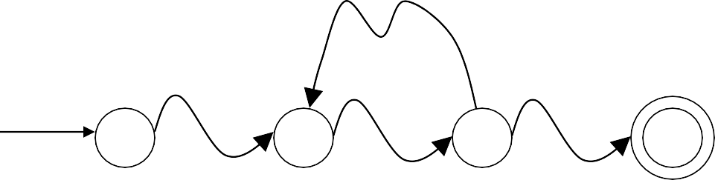

L is infinite
DFA
DFA
L is finite

Slide 62
Problem: Does DFA _{M}
accept
a finite language?
Corresponding Languag_{X} e: (Decidable)
FINITE_{DFA} =
{ M : M is a DFA that accepts a finitelanguage }

Slide 63
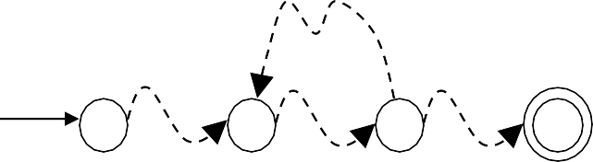
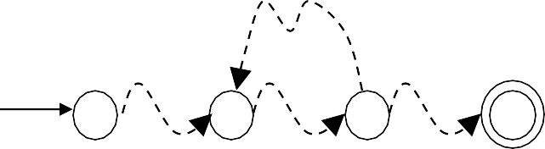
Decider for FINITE_{DFA} :
On input
M :
Check if there is a walk with a cycle
from the initial state to an accepting state
DFA M DFA M
finite Accept M
(YES)
infinite
Reject M
(NO)
Decision:

Slide 64
DFA Acceptance Problem:
Given a DFA M and an
input w, does M accept w?
Corresponding Languag_{X} e: (Decidable)
A_{DFA} = { ⟨M, w⟩ : M is a DFA that accepts input string w }
A_{DFA} is a decidable language.

Slide 65
Decider for
^{A}DFA :
On input string
M,w :
Run DFA M on input string w
If M accepts w
Then accept Else reject
M,w
(and halt) (and halt)
M,w

Slide 66
Proof.
We construct a TM M that decides A_{DFA}.
On input ⟨M,w⟩ where M is a DFA and w an input
1. Simulate M on input w
2. If the simulation ends in an accept state, accept. If it ends in a non-accepting state, reject.
Input would be the 5 tuple description of the DFA – the TM would keep track of the current state and process the input tape based on transition function and finally accept if the string’s final state is accept.
70

Slide 67
A Language about TMs/FAs/PDAs & acceptance
A_{DFA} = { ⟨M, w⟩ : M is a DFA that accepts input string w }
Let A_{DFA} be the language of all strings
<M,w> s.t.:
M is a TM/FA/PDA (coded in binary) with input alphabet also binary
w is a binary string
M accepts input w.

Slide 68
A_{NFA} ={<B,w>| B is an NFA that accepts w}
Thm:
A_{NFA} is a decidable language.

Slide 69
Proof:
N = “ On input <B,w> where B is an NFA,
and w is a string:
Convert NFA B to an equivalent DFA C using the
procedure in DFA Theorm
Run TM M from the previous Thm on input <C,w>
If M accepts, accept; otherwise reject. ”

Slide 70
A_{REX}={<R,w>| R is a regular expression that
generates string w }
Thm:
A_{REX} is a decidable language.

Slide 71
Proof:
P= “ On input <R,w> where R is a regular expression
and w is a string.
Convert R to an equivalent DFA A by the procedure given in DFA Theorm
Run TM M on input <A,w>
If M_{accepts} , accept ; if M rejects, reject. “

Slide 72
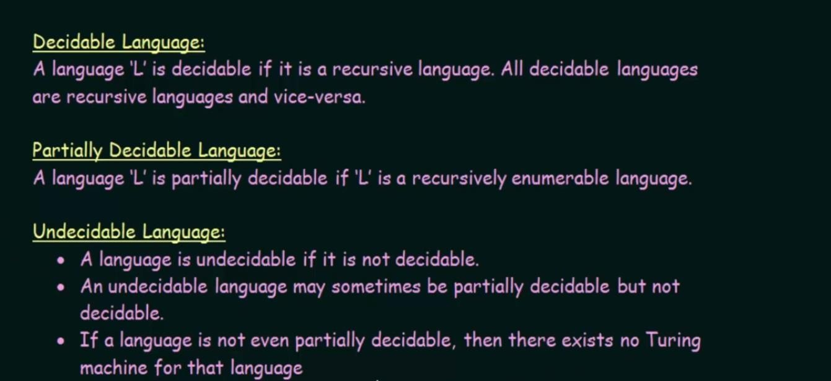

Slide 78
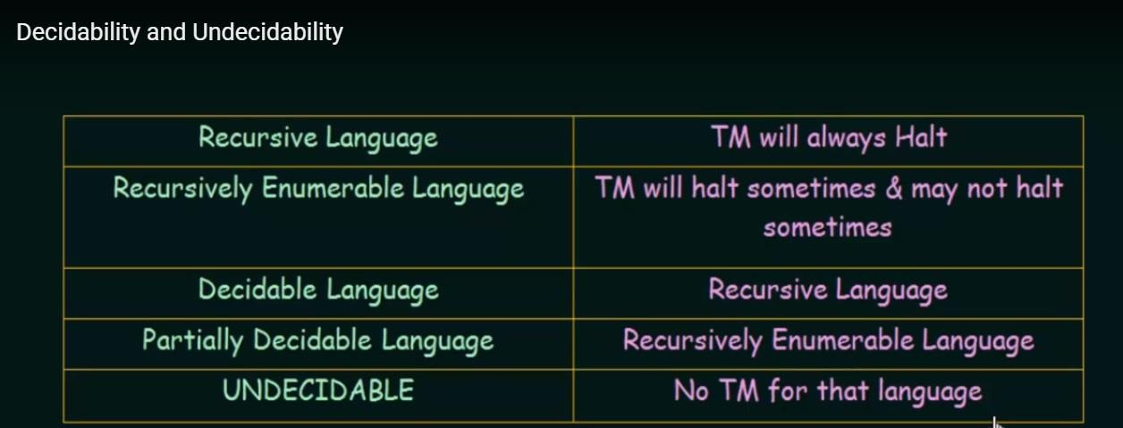

Slide 79
A_{DFA} = {(〈D〉, w): D is a DFA that accepts input w}
A_{PDA} = {(〈P〉, w): P is a PDA that accepts w}

Slide 80
Recall
Decidability/Undecidability
Recursive/Decidable Language
Recursively Enumerable/Undecidable Language
Decidable problems for Regular Language

Slide 81
Decidable Problems
of
Context Free Grammer

Slide 82
Prove that following are decidable languages.
ACFG ={(G,W)|G is a CFG that generates string W) .
ECFG ={(G,W)|G is CFG &L(G) =Ф}
(10 Marks May-2018 EndSem,Nov-2017 EndSem)

Slide 83
A_{CFG} = {⟨G,w⟩ | G is a CFG deriving string w}
Theorem. A_{CFG} is decidable.
Proof. T = “On input
1. Convert G to Chomsky Normal Form.
If w = ε check if S → ε is a rule of G and if so accept (output “accept”) and otherwise reject
2. Test all possible derivations of length 2n-1, where n = |w|.
3. If any generate w, accept, otherwise reject.”

Slide 84
A_{CFG} = {⟨G,w⟩ | G is a CFG & L(G) = ∅ }
Theorem. A_{CFG} is decidable.
Proof Note that L(G) ≠ φ if and only if G can generate some string of terminals, or the empty string. We simply determine this property for each variable u in G: can u generate a string in Σ*? This can be done by means of the following marking procedure.
Step 1 Convert the grammar to CNF (this just simplifies the rest of the description).
Step 2 Mark each variable A for which there is a rule A → a or A → ϵ (the latter could only apply to S, the start variable).
Step 3 Iteratively, mark each variable A such that there is a rule A → BC and B and C are already marked. Stop when no more variables can be marked.
Step 4 Reject if S is marked and Accept otherwise

Slide 85
Review
Decidable Language:-TM exist which definitely halt for any input string (Recursive Language )
Undecidable Language: No TM exist which definitely halt for any input string (Recursively Enumerable Language )

Slide 86
A computational problem is decidable
if the corresponding language is decidable
We also say that the problem is solvable

Slide 87
Undecidable Languages
undecidable language = not decidable language
There is no decider:
there is no Turing Machine which accepts the language and makes a decision (halts) for every input string
(machine may make decision for some input strings)

Slide 88
For an undecidable language, the corresponding problem is undecidable (unsolvable):
there is no Turing Machine (Algorithm) that gives an answer (yes or no)
for every input instance
(answer may be given for some input instances)

Slide 89
We have shown before that there are undecidable languages:
L
Turing-Acceptable
L
Decidable
L is Turing-Acceptable and undecidable

Slide 90

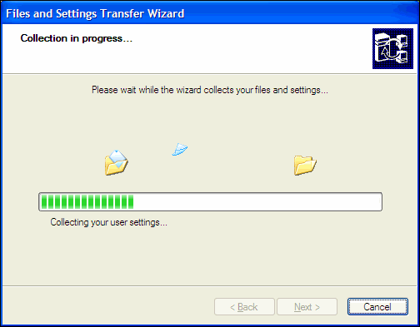



Slide 91
Halting Problem
Input: a program P in some programming language and input I for P
Output: Does P go into an infinite loop when given I? or it finish.
true if P terminates; false if P runs forever.

Slide 92
We will prove that two particular problems are unsolvable/undecidable:
Membership problem
ATM= {<M,w>| M is a TM and M accepts w}.
Halting problem
HALTTM = {<M,w>| M is a TM and M halts on w}.

Slide 93
Membership Problem
A_{TM}={<M,w>| M is a TM and M accepts w }
Thm:
A_{TM} is un-decidable .

Slide 94
(conti.)
U=“On input <M,w>, where M is a TM
and w is a string:
Simulate M on input w.
If M ever enters its accept state, accept; if M ever enters reject state, reject. “
U recognizes A_{TM} but NOT decides it!

Slide 95
The Membership Problem
Non-RE Languages
Recursively Enumerable (RE)
x
Regular Context-
Context sensitive
(DFA)
free
(PDA)
Recursive

Slide 96
Halting Problem
HALTTM = {<M,w>| M is a TM and M halts on w}.
Thm:
A_{TM} is un-decidable .

Slide 97
The Halting Problem
Non-RE Languages
Recursively Enumerable (RE)
x
Regular Context-
Context sensitive
(DFA)
free
(PDA)
Recursive

Slide 98
What is the Halting Problem?
Definition of the “halting problem”:
Given a Program, will it halt?
Does a given Turing Machine M halt on a given input w?
Input w
Machine M

Slide 99
Undecidability of Halting Program
Given a Program, will it halt?
Can we design a machine which if given program can find out or decide if that program will always halt or not halt on a particular input?
Answer:
In general we can’t always know.
The best way we can do is run the program and see whether it halts.
For Many programs we can see that it will always halt or sometimes loop.
BUT for Programs In general The Questions is Undecidable

Slide 100
Recursive, RE, Undecidable languages
No TMs exist
TMs that always halt
LBA
Non-RE Languages
(all other languages for which no TMs can be built)
TMs that may or may not halt
Recursively Enumerable (RE)
Regular Context-
Context sensitive
(DFA)
free
(PDA)
Recursive
“Undecidable” problems
“Decidable” problems

Slide 101
Decidable Language
The Membership Problem The Halting Problem
Non-RE Languages
x
x
Regular Context-
Recursively Enumerable (RE)
Context sensitive
(DFA)
free
(PDA)
Recursive

Slide 102
Halting Problem
Input: a program P in some programming language and input I for P
Output: Does P go into an infinite loop when given I? or it finish.
true if P terminates; false if P runs forever.

Slide 104
A Turing Machine simulator
Halting Problem using UTM
Given: TM M & its input w
Aim: Build another TM called “H”, that will output:
“accept” if M accepts w, and
“reject” otherwise
An algorithm for H:
Simulate M on w
Implies: H is in RE
accept,
if M halts on w
H(<M,w>) =
reject,
if M does not halt on w
Question:
If M does not halt on w, what will happen to H?

Slide 105
A Claim
Claim: No H that is always guaranteed to halt, can exist!
Proof: (Alan Turing, 1936)
By contradiction, let us assume H exists
“accept”
<M,w>
H
“reject”

Slide 106
Therefore, if H exists ➔ D also should exist.
But can such a D exist? (if not, then H also cannot exist)
HP Proof (step 1)
Let us construct a new TM D using H as a subroutine:
On input <M>:
1. Run H on input <M, <M> >; //(i.e., run M on M itself)
2. Output the opposite of what H outputs;
D
“accept”
“accept”
<M>
<M, “<M>” >
H
“reject”
“reject”

Slide 107
HP Proof (step 2)
The notion of inputing “<M>” to M itself
A program can be input to itself (e.g., a compiler is a program that takes any program as input)
accept, if M does not accept <M>
reject, if M accepts <M>
D (<M>) =
Now, what happens if D is input to itself?
accept, if D does not accept <D>
reject, if D accepts <D>
D (<D>) =
A contradiction!!! ==> Neither D nor H can exist.

Slide 108
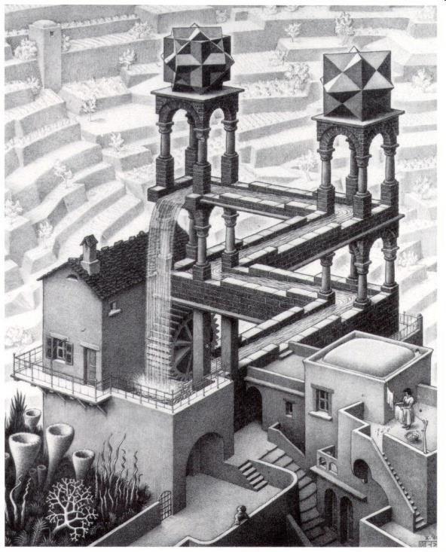

Of Paradoxes & Strange Loops
E.g., Barber’s paradox, Achilles & the Tortoise (Zeno’s paradox) MC Escher’s paintings
A fun book for further reading:
“Godel, Escher, Bach: An Eternal Golden Braid”
by Douglas Hofstadter (Pulitzer winner, 1980)

Slide 109
Which of these are Undecidable?
Does TM M accept any strings?
Undecidable
Does TM M accept all strings?
Undecidable
Undecidable
Does TM M₁ accept more strings than TM M₂?
Does TM M take more than 1000 steps to
process input w?
Decidable
Does TM M₁ take more steps than TM M₂ to
process input w?
Undecidable

Slide 110
Reducibility

Slide 111
Introduction
Method for proving that computationally unsolvable. reducibility.
A reduction is a way of
problems are It is called
converting one
problem to another problem in such a way that a solution to the second problem can be used to solve the first problem.

Slide 112
Reducibility's come up often in everyday life.
E.g. You want to find your way around a new city.
would be easy if you had a map.
Thus, you can reduce the problem of finding your way around the city to the problem of obtaining a map of the city.
Reducibility always involves two problems, which we call A and B.
If A reduces to B, we can use a solution to B to solve A.
So in our example, A is the problem of finding your way around the city and B is the problem of obtaining a map.
Note that reducibility says nothing about solving A or B alone, but only about the solvability of A in the presence of a solution to B.

Slide 113
The problem of traveling from Pune to Delhi reduces to the problem of buying a plane ticket between the two cities
the problem of measuring the area of a rectangle reduces to the problem of measuring its length and width.

Slide 114
Reducibility plays an important role in classifying problems by decidability, and later in complexity theory as well.
When A is reducible to B, solving A cannot be harder than solving B because a solution to B gives a solution to A.
In terms of computability theory, if A is reducible to B and B is decidable, A also is decidable. Equivalently, if A is undecidable and reducible to B, B is undecidable.

Slide 115
Reducability
To prove: Problem P₁ is undecidable Given/known: Problem P₂ is undecidable
■
■ | Reduction idea:
 | 1. | “Reduce” P₂ to P₁:
 |  | Convert P₂’s input instance to P₁’s input instance s.t. i) P₂ decides only if P₁ decides
 | 2. | Therefore, P₂ is decidable
 | 3. | A contradiction
 | 4. | Therefore, P₁ has to be undecidable

Slide 116
The Reduction Technique
Note:
not same as P₁ ==> P₂
Reduce P₂ to P₁:
Construct
P₂
instance
P₁
instance
Decide
yes
no
Conclusion: If we could solve P₁, then we can solve P₂ as well

Slide 117
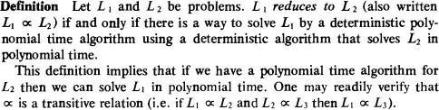
Reducibility

Slide 118
Review
Decidable Language:-TM exist which definitely halt for any input string (Recursive Language )
Undecidable Language: No TM exist which definitely halt for any input string (Recursively Enumerable Language )
Reducibility

Slide 119
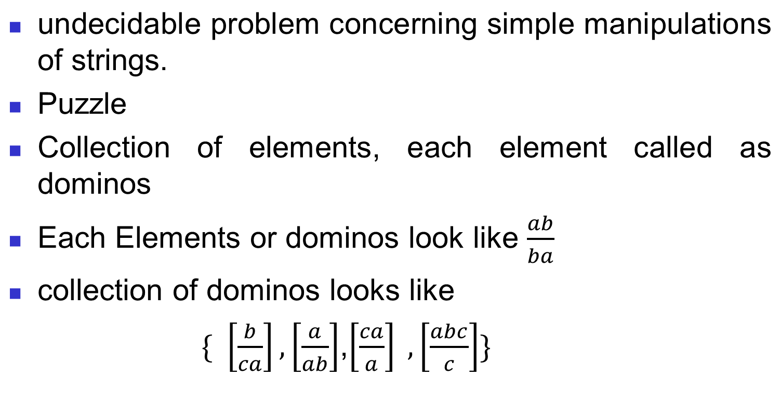
Undecidable Problem:
Post Correspondence Problem, or PCP.
■

Slide 120
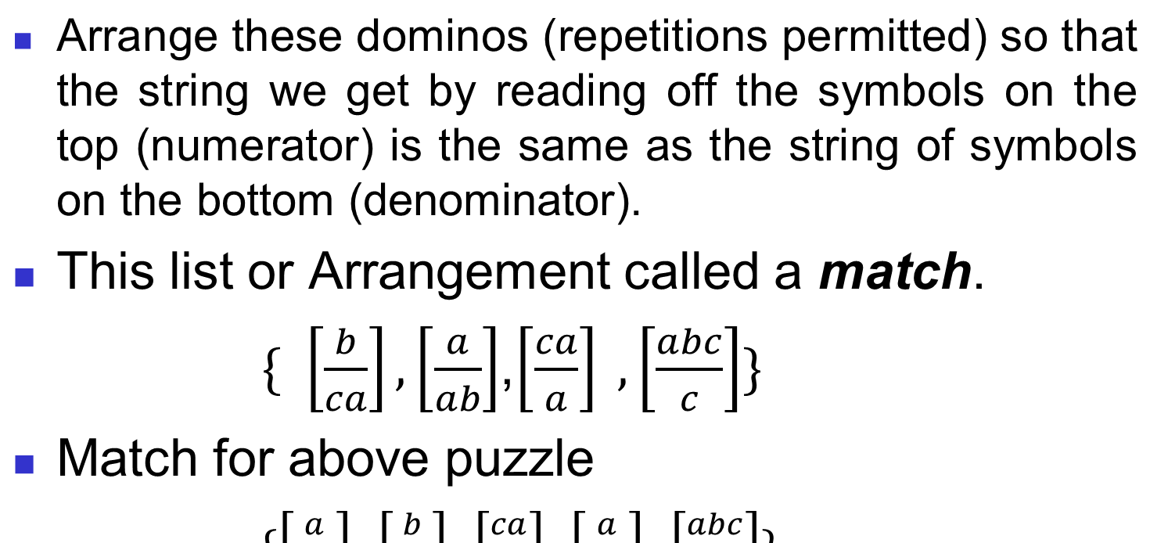
■

Slide 121
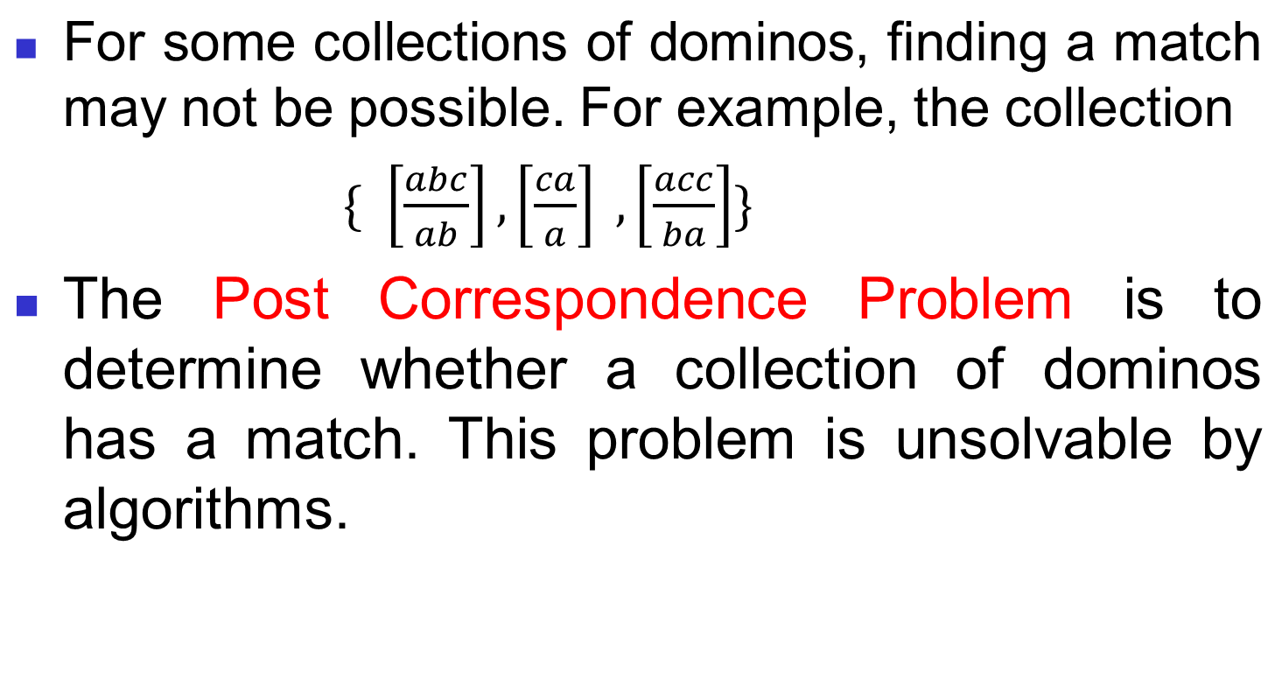
■

Slide 122
Two sets of n strings
The Post Correspondence Problem
Input:
A = w₁, w₂, …, w_{n}
B = v₁, v₂,…, v_{n}

Slide 123
i, j,…, k
There is a Post Correspondence Solution
if there is a sequence
such that:
PC-solution:
w_{i}w _{j} ☹ w_{k} = v_{i}v _{j} ☹v_{k}
Indices may be repeated or omitted

Slide 124
Example:
w₁
100
w₂
11
w₃
111
A :
v₁
001
v₂
111
v₃
11
B :
PC-solution: 2,1,3
w₂w₁w₃ = v₂v₁v₃
11100111

Slide 125
w₁
10
w₂
011
w₃
101
Example:
A :
v₁
101
v₂
11
v₃
011
B :
There is no solution

Slide 126
Example:
A :
B :
There is no solution Because total length of strings from B
is smaller than total length of strings from A
w₁ | w₂ | w₃
00 | 001 | 1000
v₁ | v₂ | v₃
0 | 11 | 011

Slide 127
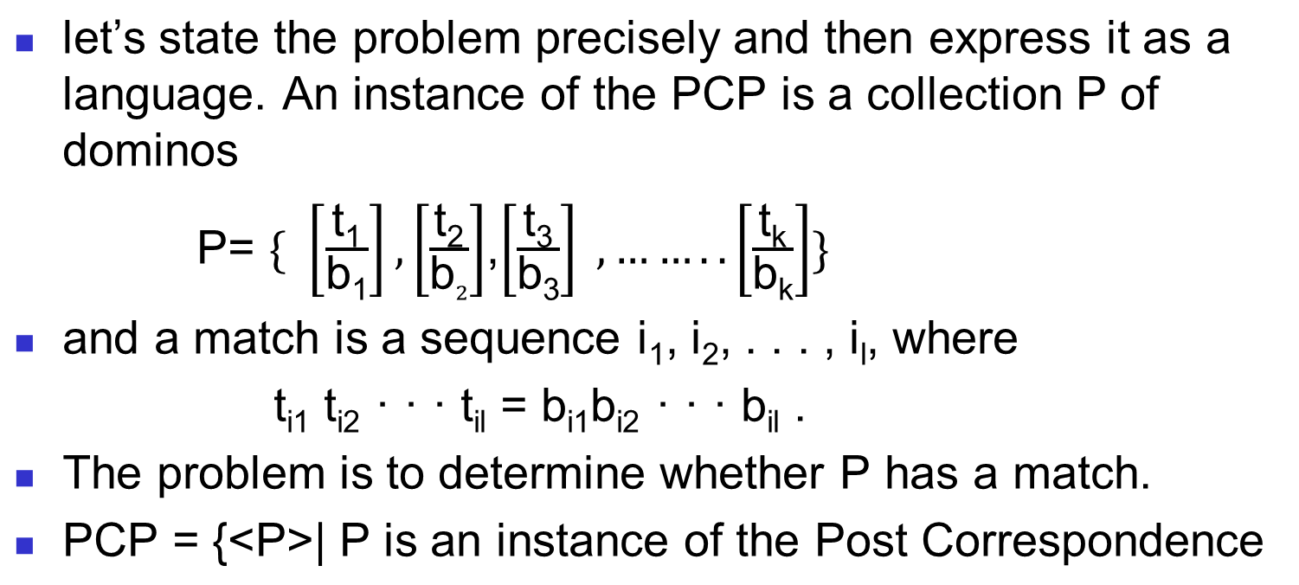
■
146

Slide 128
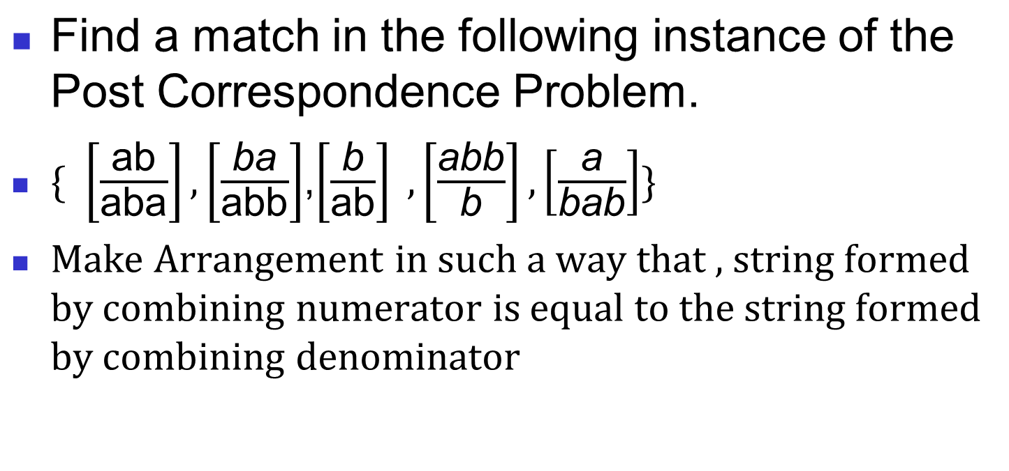
■

Slide 129
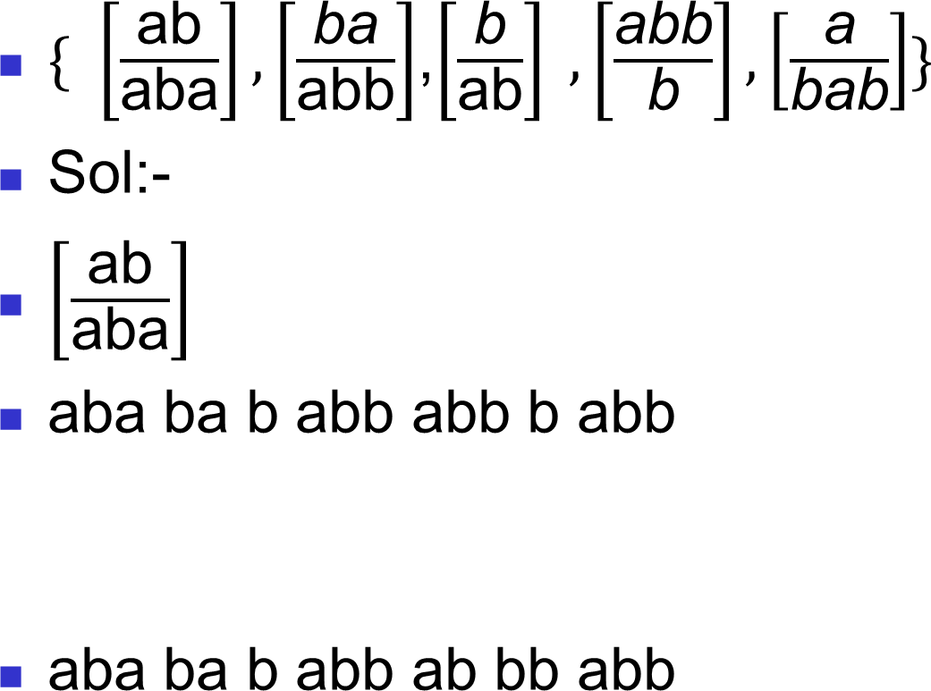
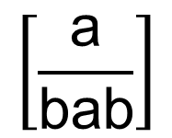
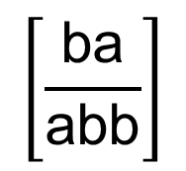
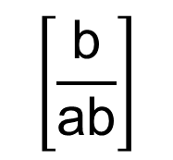
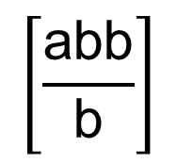
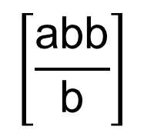


Numerator
■
Denominator
But In general there is no any algorithm present to find
out match for PCP problem

Slide 130
Time Complexity
Computability Classes: sets of problems (languages) that can be solved (decided/recognized) by a given machine.
Complexity Classes: sets of problems (languages) that can be solved (decided) by a given machine (usually a TM) within a limited amount (usually function of input size) of time or space. (Tractable)

Slide 131
Solvable and Unsolvable Problems
Problem
Solvable
Unsolvable
Decidable
Undecidable

Slide 132
Complexity definitions or Measurements
Big-Oh
Big-Theta
Big - Omega

Slide 133
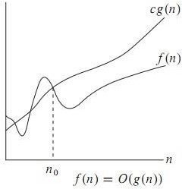
Big Oh (O)
f(n)= O(g(n)) iff there exist positive constants c and n0
such that f(n) ≤ cg(n) for all n ≥ n0
O-notation to give an upper bound on a function

Slide 134
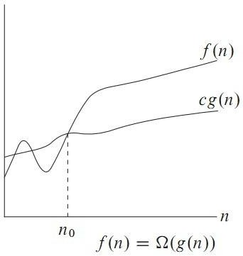
Omega Notation
Big oh provides an asymptotic upper bound on a function.
Omega provides an asymptotic lower bound on a function.

Slide 135
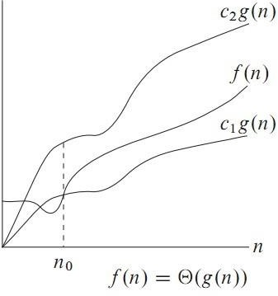
Theta Notation
Theta notation is used when function f can be bounded
both from above and below by the same function g

Slide 136
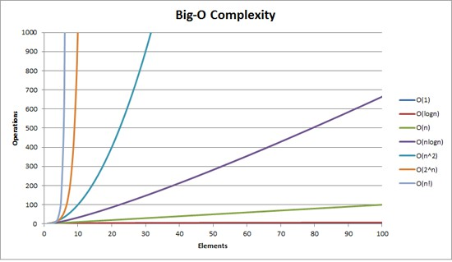
How bad is exponential complexity
Fibonacci example – the recursive fib cannot even compute fib(50)

Slide 137
The class P
The class P consists of those problems that are solvable in polynomial time.
More specifically, they are problems that can be solved in time O(n^{k}) for some constant k, where n is the size of the input to the problem
The key is that n is the size of input
An algorithm is said to be polynomially bounded if its worst- case complexity is bounded by a polynomial function of the input size. A problem is said to be polynomially bounded if there is a polynomially bounded algorithm for it.
P is the class of all decision problems that are polynomially
bounded.

Slide 138
NP
NP is not the same as non-polynomial complexity/running time. NP does not stand for not polynomial.
NP = Non-Deterministic polynomial time
NP represents the class of decision problems which can be solved in polynomial time by a non-deterministic model of computation.
NP means verifiable in polynomial time
Verifiable?
If we are somehow given a ‘certificate’ of a solution we can verify the legitimacy in polynomial time

Slide 139


Outline
Turing Machine , Turing Degree
Polynomial and non polynomial problems
Deterministic and non deterministic algorithms P
,NP, NP hard and NP Complete
NP Complete Proof- 3-SAT & Vertex Cover NP hard Problem- Hamiltonian Cycle
Menagerie of complexity classes of Turing Degree Randomization- Sorting algorithm
Approximation-TSP and Max Clique

Slide 140
Polynomial Problems
Polynomial is an expression consisting of variables (or indeterminates) and coefficients,
that involves only the operations of addition, subtraction, multiplication, and non-negative integer exponents.
An example of a polynomial of a single indeterminate (or variable), x, is x² − 4x + 7.
An Example of Polynomial algorithm is 0(log n)

Slide 141
Non-Polynomial Problems
The set or property of problems for which no polynomial-time algorithm is known.
This includes problems for which the only known algorithms require a number of steps which increases exponentially with the size of the problem, and those for which no algorithm at all is known.
Within these two there are problems which are " provably difficult " and " provably unsolvable ".

Slide 142
Outline
Turing Machine , Turing Degree
Polynomial and non polynomial problems Deterministic and non deterministic
algorithms P ,NP, NP hard and NP Complete NP Complete Proof- 3-SAT & Vertex Cover NP hard Problem- Hamiltonian Cycle
Menagerie of complexity classes of Turing Degree Randomization- Sorting algorithm
Approximation-TSP and Max Clique

Slide 143
Deterministic Algorithm
Deterministic algorithm is an algorithm which, given a particular input, will always produce the same output, with the underlying machine always passing through the same sequence of states.

Slide 144
Nondeterministic algorithm
Nondeterministic algorithm is an algorithm that, even for the same input, can exhibit different behaviors on different runs, as opposed to a deterministic algorithm.
An algorithm that solves a problem in nondeterministic polynomial time can run in polynomial time or exponential time depending on the choices it makes during execution.
The nondeterministic algorithms are often used to find an approximation to a solution, when the exact solution would be too costly to obtain using a deterministic one.

Slide 145
Outline
Turing Machine , Turing Degree
Polynomial and non polynomial problems Deterministic and non deterministic
algorithms P ,NP, NP hard and NP Complete NP Complete Proof- 3-SAT & Vertex Cover NP hard Problem- Hamiltonian Cycle
Menagerie of complexity classes of Turing Degree Randomization- Sorting algorithm
Approximation-TSP and Max Clique

Slide 146
P Class
The informal term quickly, used above, means the existence of an algorithm for the task that runs in polynomial time.
The general class of questions for which some algorithm can provide an answer in polynomial time is called "class P" or just "P".

Slide 147
NP Class
For some questions, there is no known way to find an answer quickly, but if one is provided with information showing what the answer is, it is possible to verify the answer quickly.
The class of questions for which an answer can be verified in polynomial time is called NP.

Slide 148
NP- Hard Class
NP-hard (Non-deterministic Polynomial-time hard), is a class of problems that are, informally, "at least as hard as the hardest problems in NP".
More precisely, a problem H is NP-hard when every problem L in NP can be reduced in polynomial time to H.
As a consequence, finding a polynomial algorithm to solve any NP-hard problem would give polynomial algorithms for all the problems in NP, which is unlikely as many of them are considered hard

Slide 149
NP Complete Class
In computational complexity theory, a decision problem is NP-complete when it is both in NP and NP-hard.
The set of NP-complete problems is often denoted by NP-C or NPC.
The abbreviation NP refers to "nondeterministic polynomial time".

Slide 150
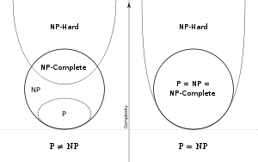
Relation between P,NP,NP hard and NP Complete

Slide 151




Outline
Turing Machine , Turing Degree
Polynomial and non polynomial problems Deterministic and non deterministic
algorithms P ,NP, NP hard and NP Complete
NP Complete Proof- 3-SAT & Vertex Cover
NP hard Problem- Hamiltonian Cycle
Menagerie of complexity classes of Turing Degree
Randomization- Sorting algorithm Approximation-TSP and Max Clique

Slide 152




3-Satisfiability(3-SAT)
Instance: A collection of clause C where each clause contains exactly 3 literals, boolean variable v.
Question: Is there a truth assignment to v so that each clause is satisfied?
Note: This is a more restricted problem than normal SAT. If 3-SAT is NP-complete, it implies that SAT is NP- complete but not visa-versa, perhaps longer clauses are what makes SAT difficult?
SAT is trivial.
SAT is in P

Slide 153
3-SAT is NP-Complete
Theorem: 3-SAT is NP-Complete
Proof:
3-SAT is NP. Given an assignment, we can just
check that each clause is covered.
3-SAT is hard. To prove this, a reduction from SAT to 3-SAT must be provided. We will transform each clause independently based on its length.

Slide 154
What happened to automata?
Problem is in NP iff it is decidable by some non
deterministic Turing machine in polynomial time.
Remember that the model we have used so far is a
deterministic Turing machine
It is provable that a Non Deterministic Turing Machine is
equivalent to a Deterministic Turing Machine
Remember NFA to DFA conversion?
Given an NFA with n states how many states does the equivalent DFA have?
Worst case …. 2^{n}
The deterministic version of a poly time non deterministic
Turing machine will run in exponential time (worst case)

Slide 155
NP problems
Graph theory has these fascinating(annoying?) pairs of problems
Shortest path algorithms?
Longest path is NP complete (we’ll define NP
complete later)
Eulerian tours (visit every vertex but cover every edge only once, even degree etc). Solvable in polynomial time!
Hamiltonian tours (visit every vertex, no vertices can be repeated). NP complete

Slide 156


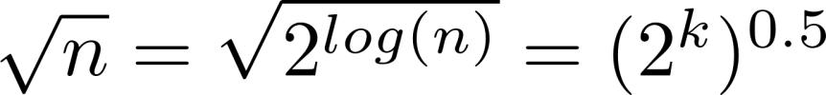
What is the complexity of primality testing?
public static boolean isPrime(int n){ boolean answer = (n>1)? true: false;
for(int i = 2; i*i <= n; ++i)
{
System.out.printf("%d\n", i); if(n%i == 0)
{
answer = false; break;
}
}
return answer;
}
This loops until the square root of n So this should be
But what is the input size? How many bits does it take to represent the number n? log(n) = k
What is
Naïve primality testing is exponential!!

Slide 157
Hamiltonian cycles
Determining whether a directed graph has a Hamiltonian cycle does not have a polynomial time algorithm (yet!)
However if someone was to give you a sequence of vertices, determining whether or not that sequence forms a Hamiltonian cycle can be done in polynomial time
Therefore Hamiltonian cycles are in NP

Slide 158
Summary
Problems vs. languages
Decidability
Recursive
Undecidability
Recursively Enumerable
Not RE
Examples of languages
The diagonalization technique
Reducibility
Time Complexity

